Slide 1
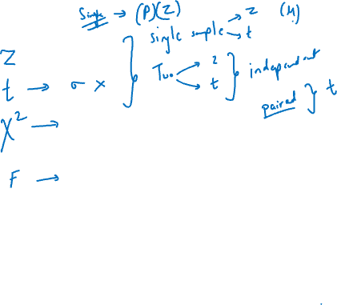
ANOVA & Chi Square test

Slide 2
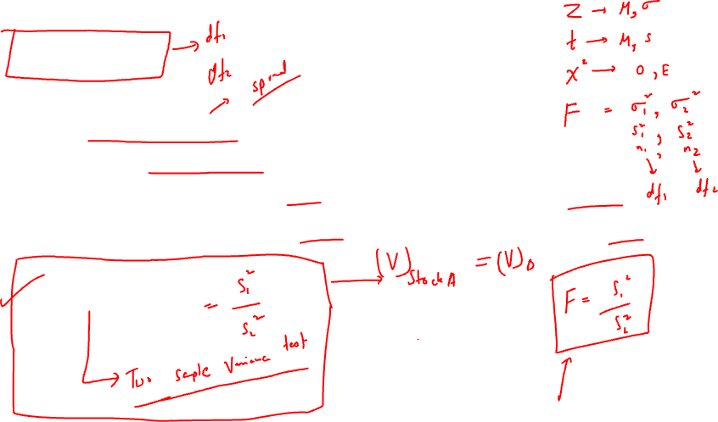
F statistic
It is a ratio of variances of two groups.
Since it has two variances, it deals with two degrees of freedom.
For variance in numerator V1 the degrees of freedom is (n1-1)
For variance in denominator V2 the degrees of freedom is (n2-1)
F = V1/ V2

Slide 3
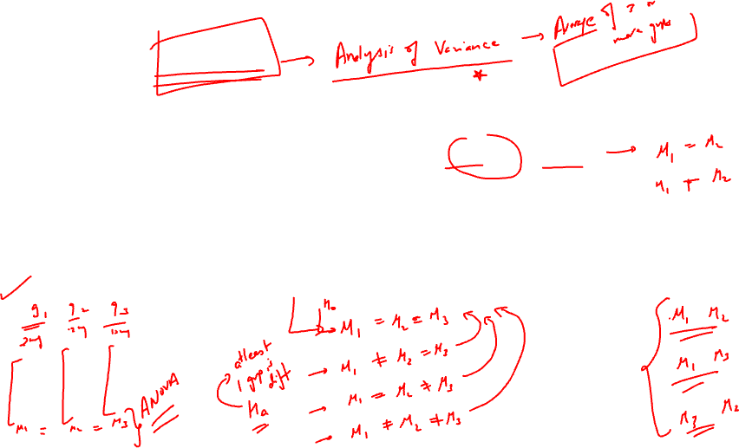
One Way ANOVA
When there are two groups two be compared (two independent samples) , we can comfortably make use of t test or z test.
But suppose you want to compare the means of 3 or more groups, in that case t test does not help.
One way ANOVA is used to compare means of 3 or more groups.

Slide 4
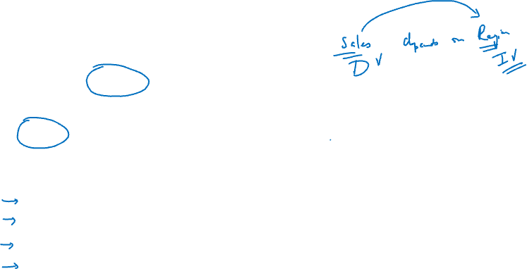
Example:
There are five regions is a company and you want to compare the sales generated by employees of each region.
Here sales depends on the different region.
R1 | R2 | R3 | R4 | R5
25000 | 26000 | 46000 | 8000 | 26000
35000 | 40000 | 58000 | 10000 | 35000
30000 | 16000 | 36000 | 15000 | 16000
31000 | 10000 | 40000 | 9000 | 9000

Slide 5
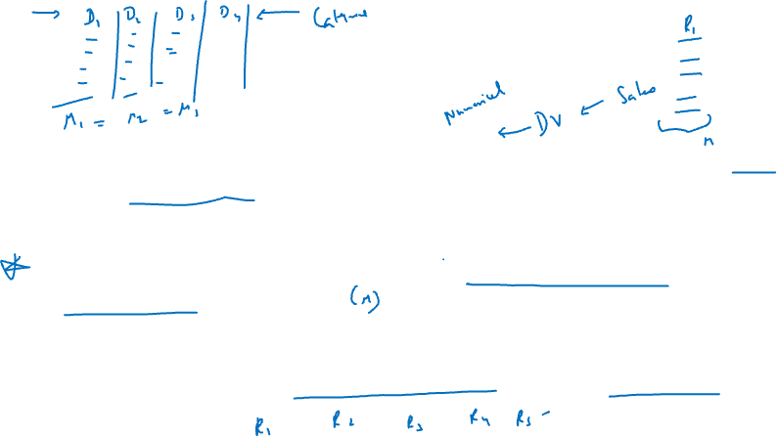
It can be observed that since sales depends on the regions, sales is the dependent variable and regions are independent variables.
ANOVA is specifically used when the dependent variable is QUANTITATIVE in nature.
The aim is to see the mean difference in sales for different regions.

Slide 6
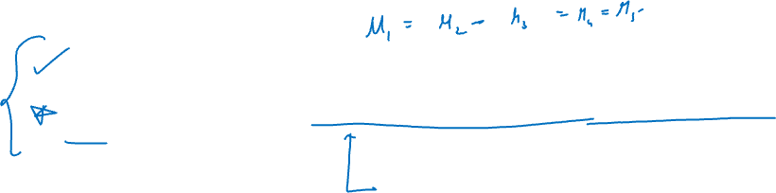
Null hypothesis: There is no difference in the mean sales of all regions
Alternative hypothesis: Atleast one region has significantly different sales.

Slide 7
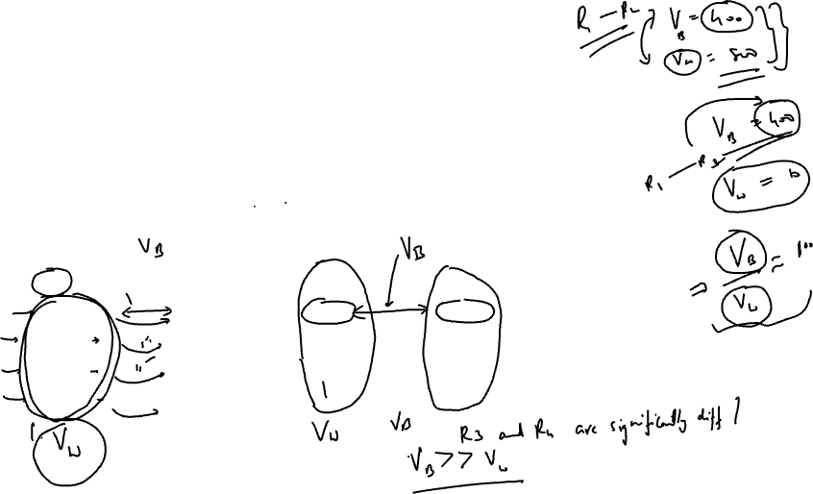
ANOVA means analysis of variance.
It is true that all values are different from each other. So there is inherent variation in the values.
If you observe the values within region R1, they all vary from each other.
And then there is variation in values between different regions as well.
R1 | R2 | R3 | R4 | R5
25000 | 26000 | 46000 | 8000 | 26000
35000 | 40000 | 58000 | 10000 | 35000
30000 | 16000 | 36000 | 15000 | 16000
31000 | 10000 | 40000 | 9000 | 9000

Slide 8
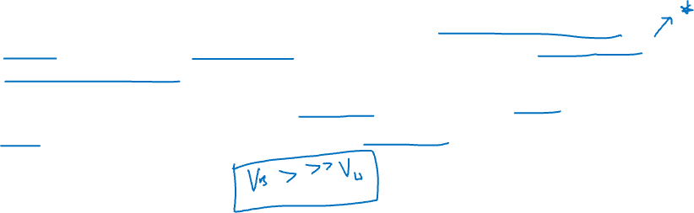
So ANOVA basically works on the concept of analyzing the variance within a group and between the groups. That gives the total variation of the observations.
Our aim is to find if the variation between the columns (regions) or groups is significant as compared to variation within each group.

Slide 9
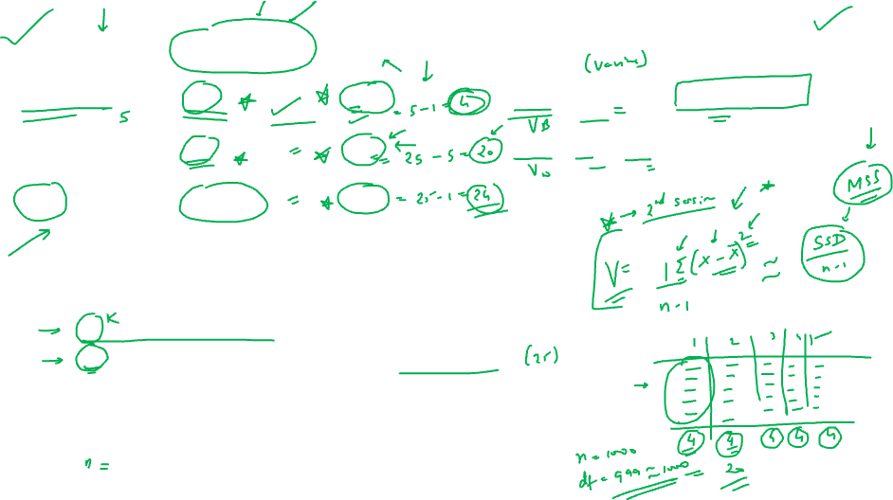
Source of variation | Sum of squares | df | Mean sum of squares | F
Between groups | SSB | K – 1 | MSSB = SSB / (k-1) | F = MSSB / MSSW
Within groups | SSW | N-k | MSSW = SSW / (N-k)
Total | SST (total) | N-1
SSB = sum of squares between columns
SSW = sum of squares within each group
SST = SSB + SSW = sum of squares total
K = number of groups
N = total number of observations in all groups
MSSB = mean of sum of squares between
MSSW = mean of sum of squares within
F = test statistic for ANOVA

Slide 10
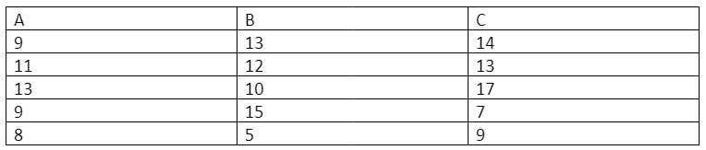
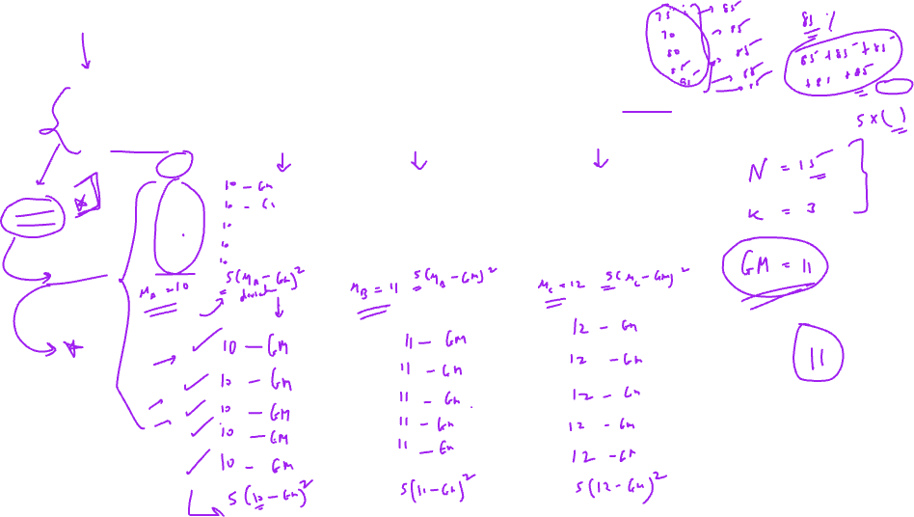
Q1: To assess the significance of possible variation in performance in a certain test between the convent schools of a city, a common test was given to a number of students taken at a random from the 5th class of the 3 schools concerned. The result is given as follows

Slide 11
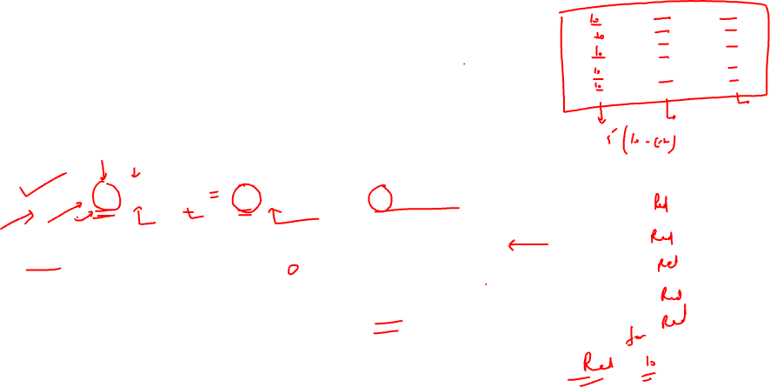
Step first: find mean of each group
Step second: find grand mean of all values
K = 3, N = (5+5+5) = 15

Slide 12
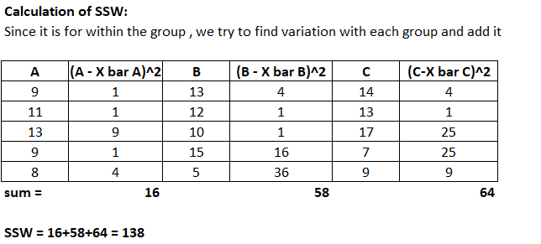
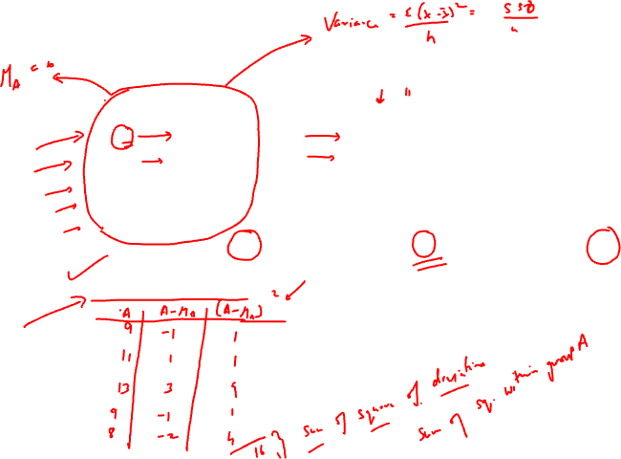

Slide 13
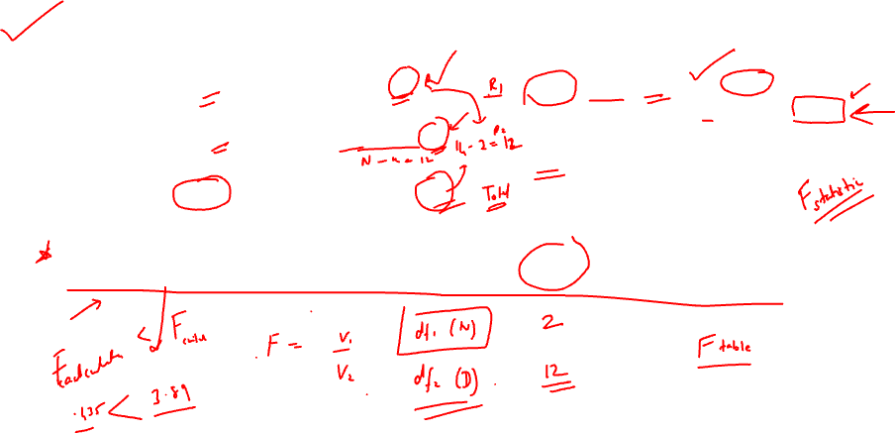
Source of variation | Sum of squares | df | Mean sum of squares | F
Between groups | 10 | 3-1=2 | MSSB = 10 /2 = 5 | F = MSSB / MSSW F = 5/11.5 = 0.435
Within groups | 138 | 15 – 3 = 12 | MSSW = 138 /12 = 11.5
Total | 148 | 15 – 1 = 14
F critical value : Check F table for alpha = 0.05 df1 = 2 , df2 = 12

Slide 14
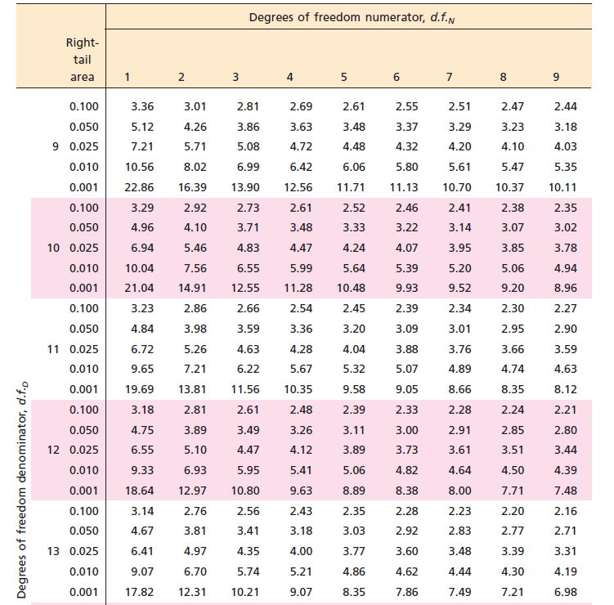
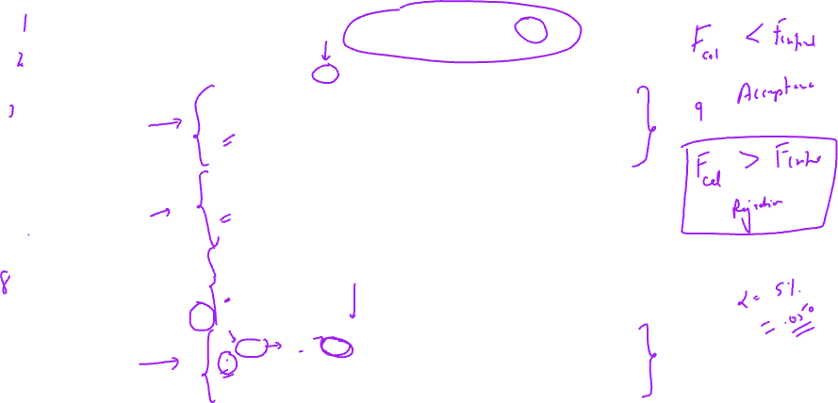

Slide 15
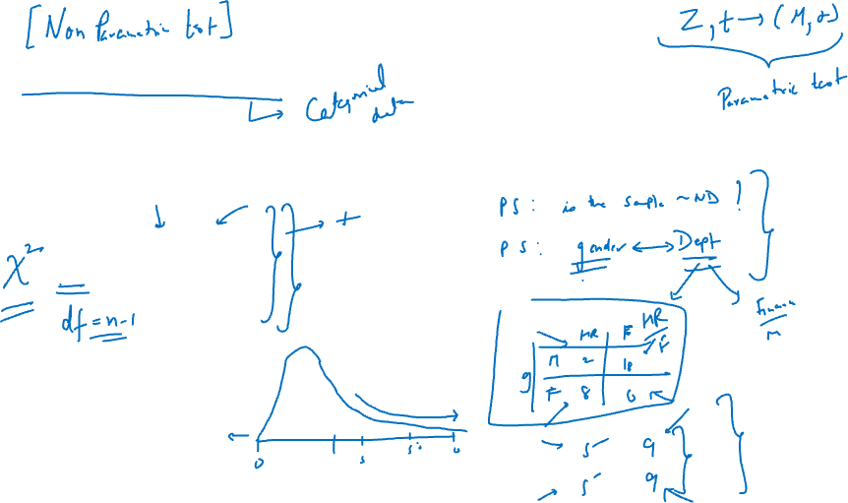
Chi square test
Chi square statistic compares the difference between observed and expected values.
Where:
O = observed value
E = Expected value

Slide 16
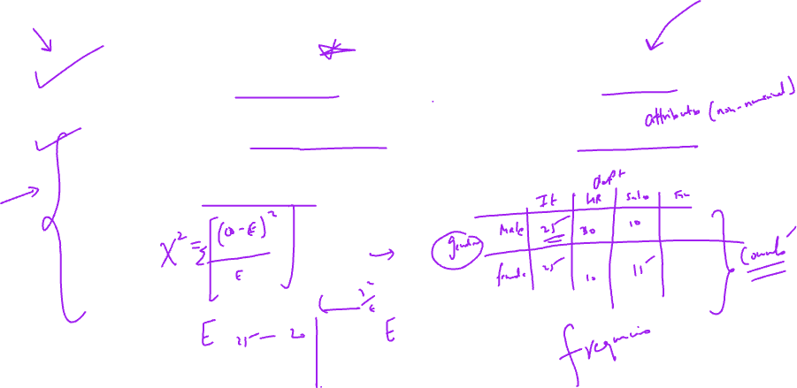
Two types of Chi square test
Chi square test of goodness of fit: This checks if the sample data fits in the actual population distribution
Chi square test of independence: It checks whether two variables are related or not. (Here there are two independent variables All the variables are categorical in nature)

Slide 17
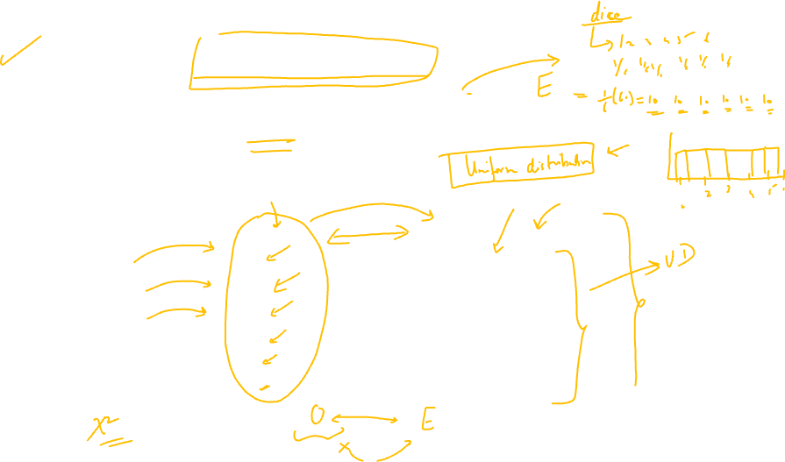
Example of goodness of fit
Suppose you throw a dice 60 times. Following are the actual observations after the experiment
Since each outcome has equal chance of occurrence (theoretically)
Outcome on dice | Observed | Expected
1 | 12 | (1/6) * 60 = 10
2 | 15 | (1/6) * 60 = 10
3 | 7 | (1/6) * 60 = 10
4 | 11 | (1/6) * 60 = 10
5 | 8 | (1/6) * 60 = 10
6 | 7 | (1/6) * 60 = 10

Slide 18
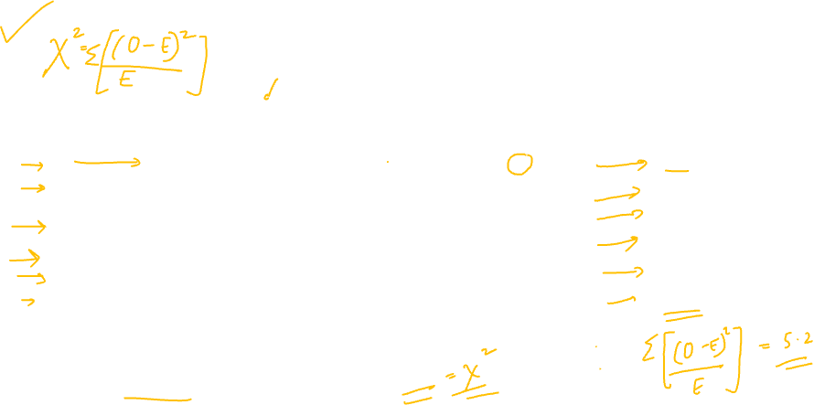
Outcome | Observed ( O ) | Expected (E ) | (O – E)^2 | (O – E)^2 / E
1 | 12 | 10 | 4 | 0.4
2 | 15 | 10 | 25 | 2.5
3 | 7 | 10 | 9 | 0.9
4 | 11 | 10 | 1 | 0.1
5 | 8 | 10 | 4 | 0.4
6 | 7 | 10 | 9 | 0.9
Chi square (statistic) = 0.4+2.5+0.9+0.1+0.4+0.9 = 5.2

Slide 19
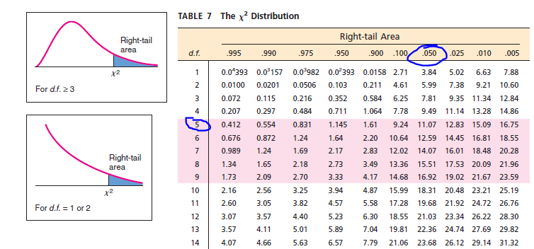
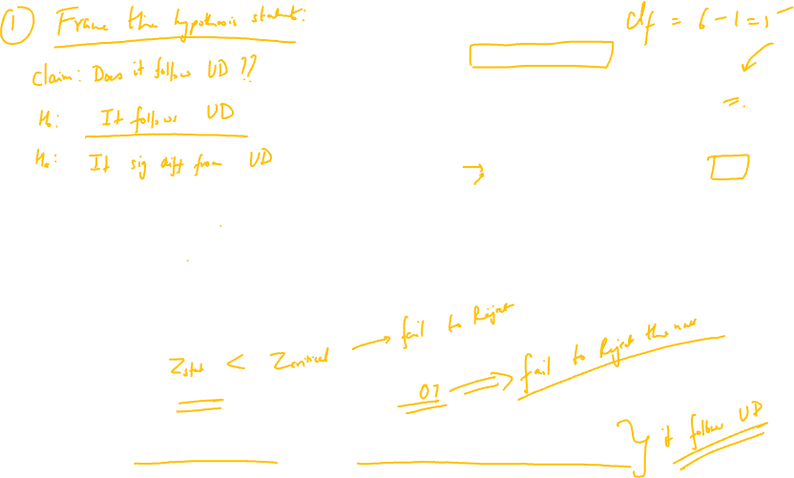
Chi Square critical = 11.07
Chi square statistic 5.2 < chi square critical value 11.2
Hence the observed values are NOT significantly different than the expected values

Slide 20
AB testing (Interview Question)
A/B testing is a method of analyzing the two versions of the same variable.
Also called split testing or bucket testing.
Use case: Suppose there are two versions of a dashboard.
You let two independent samples use those dashboards and then compare their mean experiences.
Hypothesis testing is used to compare between the two versions: A and B.

